Slide 1
Linked List

Slide 2
Operations on a Linked List

Slide 3
Operations on a Linked List
1. Traversal: Visiting each node in the LL.
2. Insertion: Inserting a new node in the LL.
3. Deletion: Deleting a node in the LL.

Slide 4
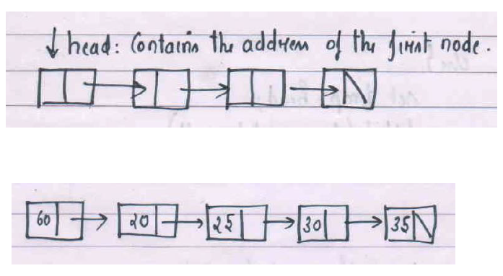
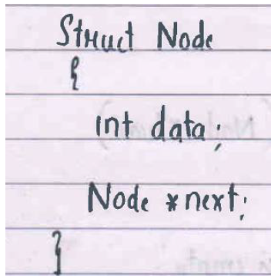
Traversing the Linked List
Process of Visiting each node in the list.

Slide 5
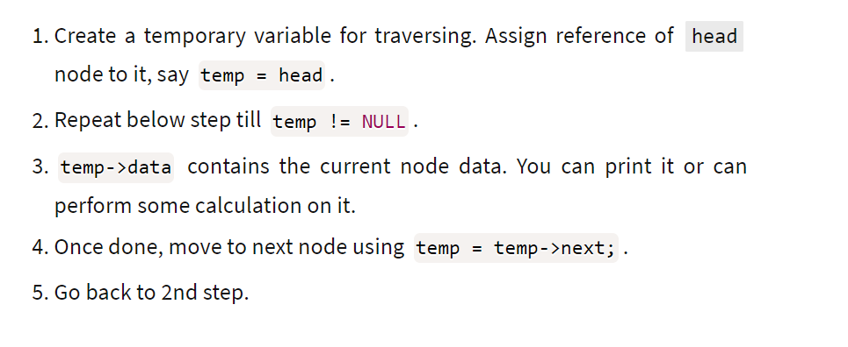
Assumption list is not empty
Time complexity= O(n), where n number of nodes in LL

Slide 6
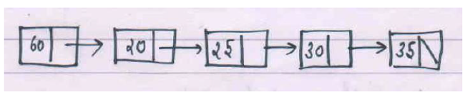
Traversal Logic :
Algorithm Traversal(Node head){
if( head==null) print list is empty.
else{
Node temp=head;
while(temp!=null){
print(temp.data);
temp=temp.next;
}
}
}
Time Complexity = O(n)
}

Slide 7
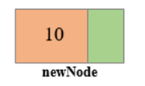
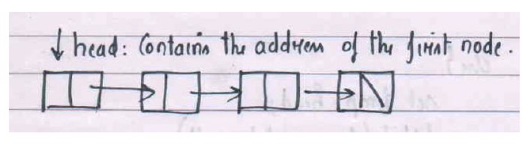
2. Insertion In Linked List.
Insert_ AT_ head(value)
Insert_ AT_Tail(value)
Insert_ AT_Middle(value, position)
Common step in all these insertions is creation of newnode. Assign Data part =value and Address part to null.
Example : newnode.data=10; newnode.next=null.

Slide 8
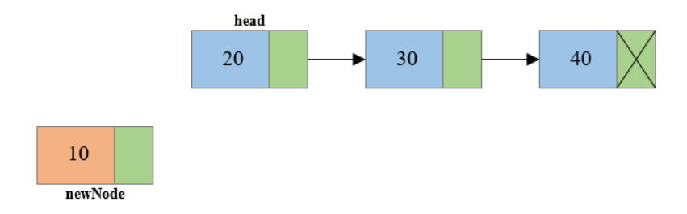
Insert_ AT_ head(value)
Step 1: Create a new node, say newNode points to the newly created node.
newnode.data=10; newnode.next=null

Slide 9
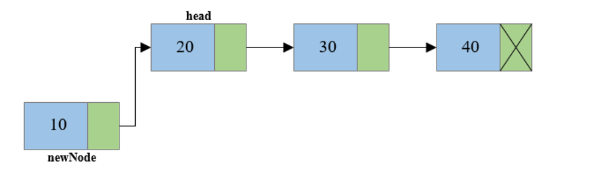
Step 2: Link the newly created node with the head node, i.e. the newNode will now point to head node.
newnode.next= head.

Slide 10
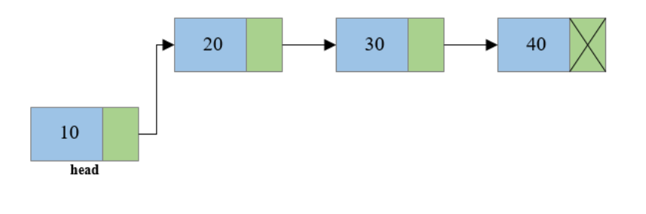
Step 3: Make the new node as the head node, i.e. now head node will point to newNode. ( Statement is head=newnode)

Slide 11
Insert_ AT_ head(value): Logic
Step 1: Create a new node, say newNode points to the newly created node.
newnode.data=10; newnode.next=null
Step 2: Link the newly created node with the head node, i.e. the newNode will now point to head node.
newnode.next= head.
Step 3: Make the new node as the head node, i.e. now head node will point to newNode.
// Write the node definition before writing the steps. No need to draw the diagrams
Time Complexity of Insert_ At_head= O(1)

Slide 12
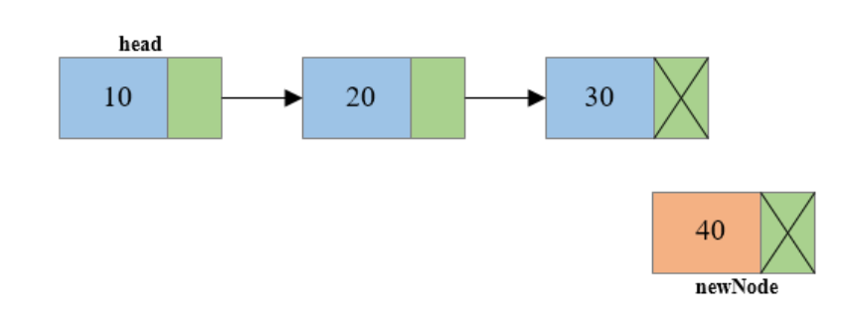
Insert_ AT_Tail(value): Insert a new node at the end
Logic:

Slide 13
Step 1: Create a new node, say newNode points to the newly created node.
newnode.data=10; newnode.next=null.

Slide 14
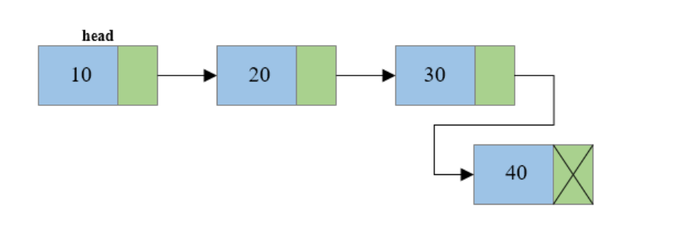
Step 2: Traverse to the last node of the linked list and connect the last node of the list with the new node. Call Traversal().
i.e. last node will now point to new node. (temp->next = newNode).
Time Complexity of Insert_ At_head= O(n)

Slide 15
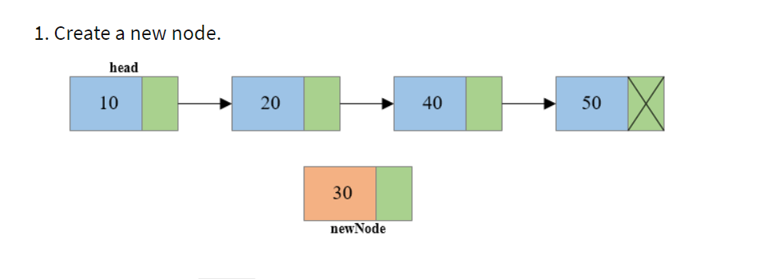
Insert_At_Mid(value,n) // Position is n
Example Insert_At_Mid(30,3)

Slide 16
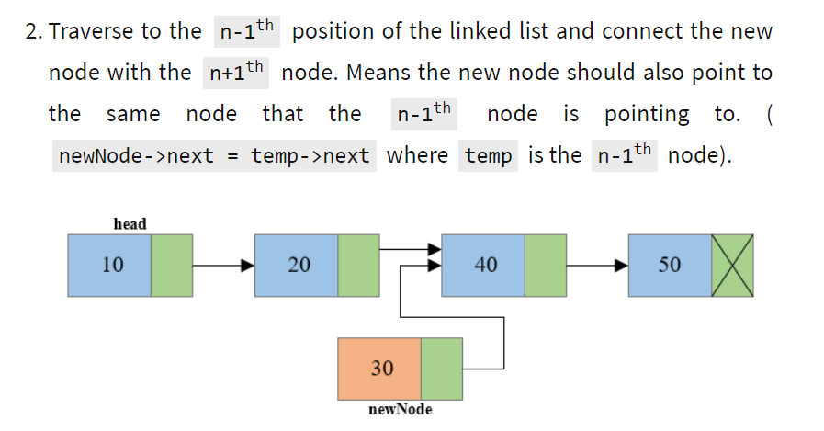
Use traversal to reach n-1th node . After this temp will be n-1th node

Slide 17
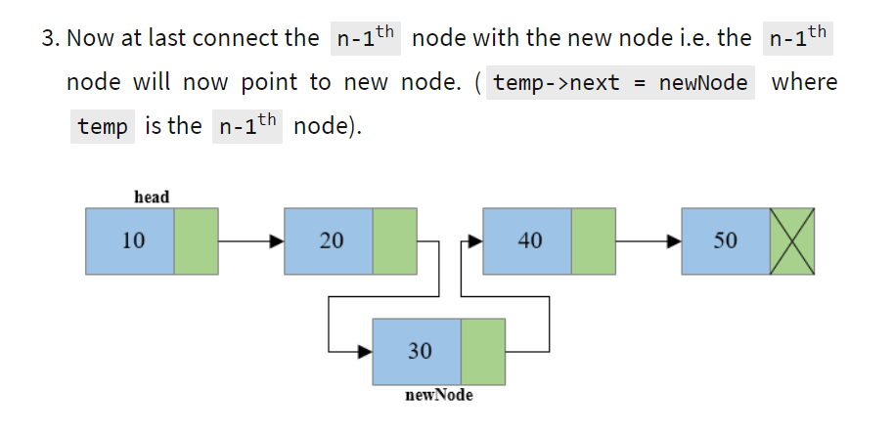
Insert_At_Mid() // Position is n

Slide 18
Insertion Summary:
Insert_ AT_ head() - Time complexity O(1)
Insert_ AT_Tail() - Time complexity O(n)
Insert_ AT_Middle(k)- Time complexity O(K) ; K is the position

Slide 19
Deletion In Linked List.
Delete_ AT_ head()
Delete_ AT_Tail()
Delete_ AT_Middle(K): K is the position of the node that has to be deleted.

Slide 20
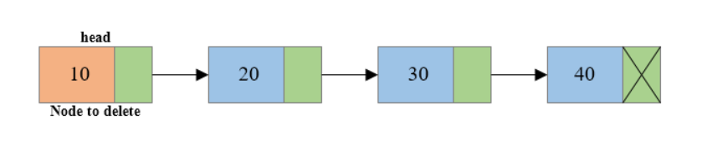
Delete_ AT_ head()
Logic :

Slide 21
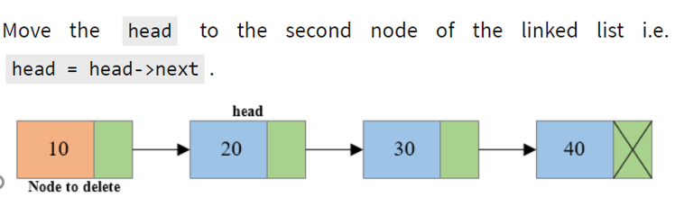
Step 1: Store temp= head.
Step 2:

Slide 22
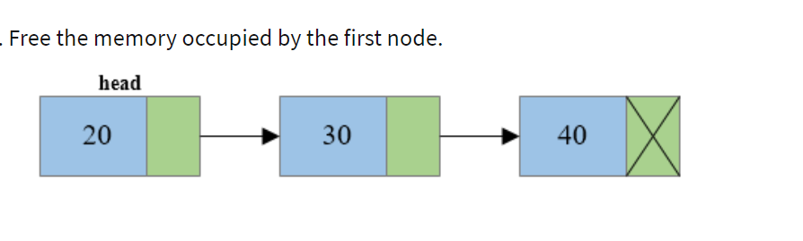

Step 3: Make temp=null.
Time Complexity for Delete_AT_Head() is O(1)

Slide 23
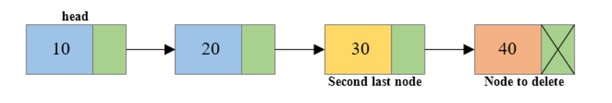
Delete_ AT_Tail()
Logic:
Modify the traversal to track the second Last element . Once we track the second last element set the second last node. next=null.
How to track the second last node? Refer this

Slide 24
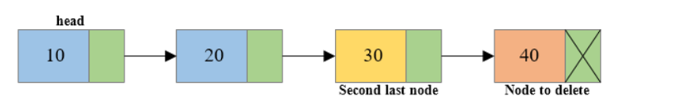
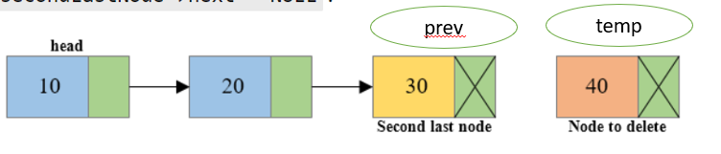
Step 1: Traverse to the last node of the linked list keeping track of the second last node in some temporary variable say prev. ( here temp will be the last node)
Step 2: Disconnect the second last node with the last node i.e. prev->next =NULL.

Slide 25
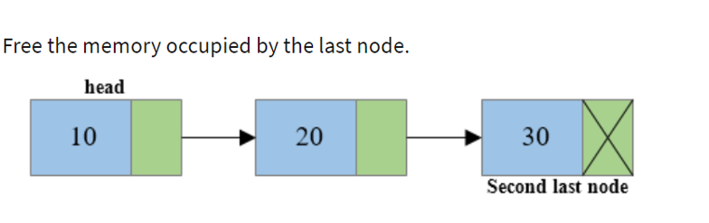

Step 3: Make temp=null .
Time Complexity for Delete_AT_Tail() is O(n) where n number of nodes.

Slide 26
Step 1 Explanation: Tracking second last node. For your understanding
Algorithm Traversal_ Second last node(Node head){
if( head==null) print list is empty.
else{
Node prev=head;
Node temp=head;
while(temp.next!=null){
prev=temp; // After the while loop prev contains the second last element. temp=temp.next; // After the while loop temp contains the last element.
}
} Back
}
Not there for the exam

Slide 27
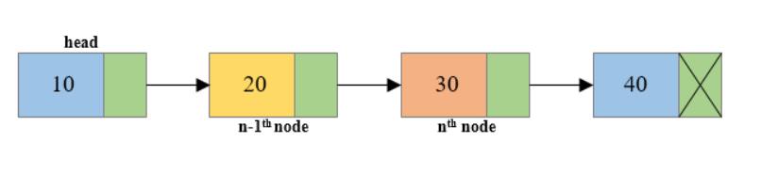
Delete_ AT_Middle(n) : // where n is the position.
Logic:
Here n denotes the position.

Slide 28
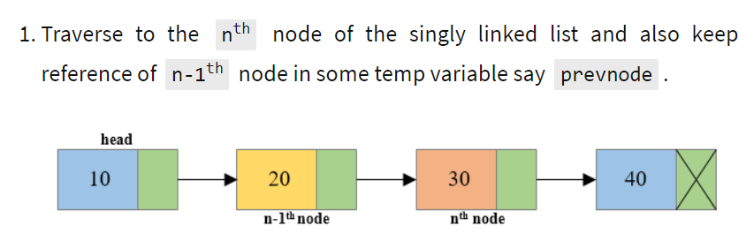
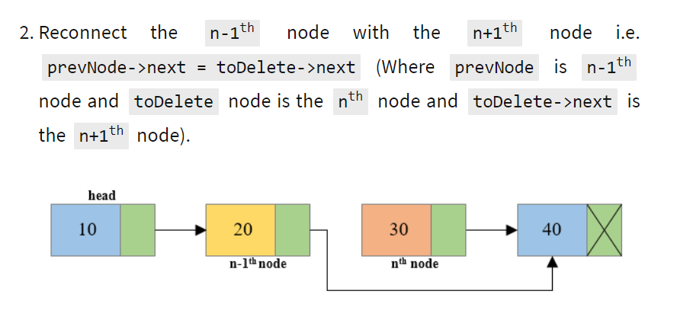
prevNode
toDelete
Assume PrevNode and toDelete are Node references
for n-1 th node and n th node
prevNode
toDelete

Slide 29
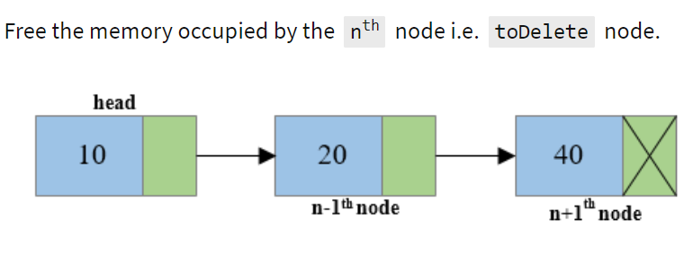
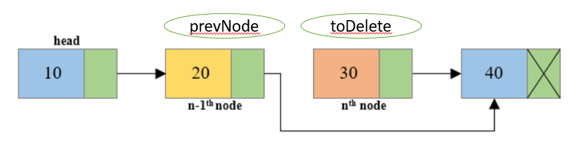
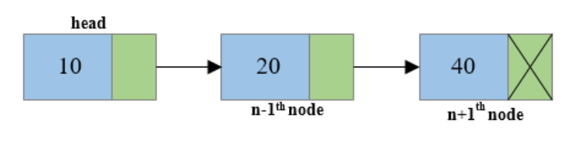
3. Make toDelete=null

Slide 30
Deletion Summary:
Delete_ AT_ head() - Time complexity O(1)
Delete_ AT_Tail() - Time complexity O(n) : n: number of nodes
Delete_ AT_Middle(k)- Time complexity O(K) ; K is the position

Slide 31
Stack using Linked List
In Stack insertion and deletion should happen at one end.
Option 2 option 1
Option 1: Perform insert and delete at tail end of LL. Both Takes O(n)
Option 2:Perform insert and delete at head end of LL. Both Takes O(1)

Slide 32
Stack using Linked List
Option 2 is correct: Perform insert and delete at head end of LL. Both Takes O(1), Because stack push( Insert) and pop( delete) takes O(1) time.
Insert_AT_Head( Value) = Push(value)
Delete_AT_Head()=pop().
Head reference we call it as top. ( the end through which insertion and deletion happens)

Slide 33
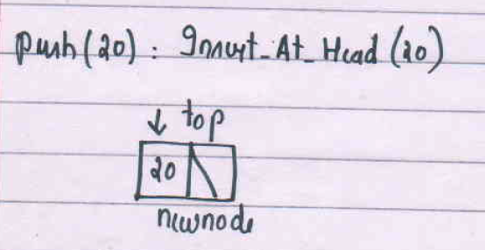
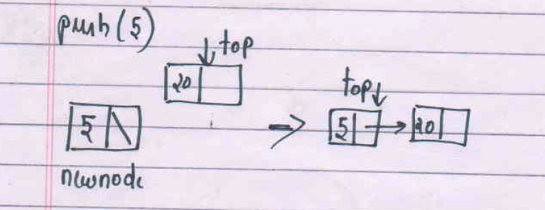
Push() and pop() explained.
Make newnode.next=
newnode.next= top and top=newnode.

Slide 34
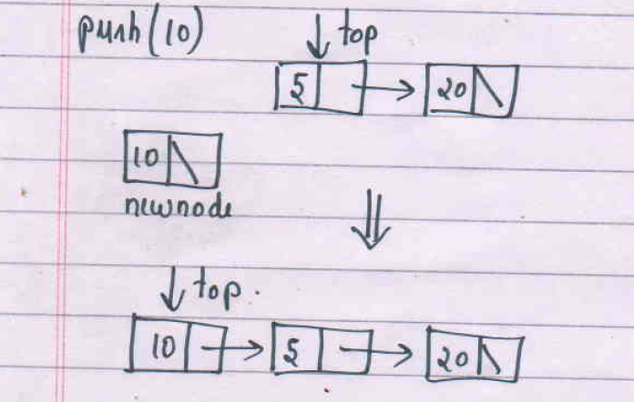
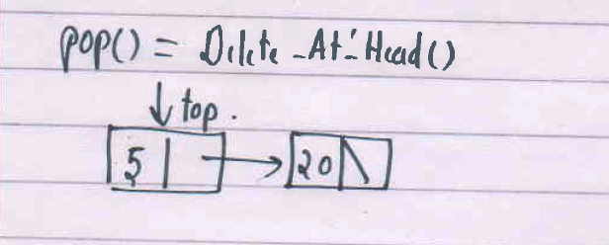

Slide 35
Stack using Linked List
Push(value)
Step 1: Create a newnode.
newnode.data= value, newnode.next=null.
Step 2: Make newnode.next=top and top =newnode.
Pop()
temp=top;
top=top.next.
temp=null.
Both push(value) and pop() takes constant time. ie O(1)

Slide 36
Queue using Linked List:
In Queue insertion and deletion should happen at different ends.
Option 1: Perform insert at head and delete at tail end of LL.
Option 2:Perform insert at tail and delete at head end of LL.
One of the option in both operation is costly.

Slide 37
Enqueue is Insert_At_Tail()
Consider the second option : Perform insert at tail and delete at head end of LL
For insert_At_Tail: Maintain a tail pointer also that contains the address of the last node
head refers to the front pointer and tail refers to the rear pointer

Slide 38
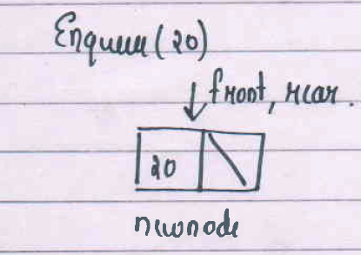
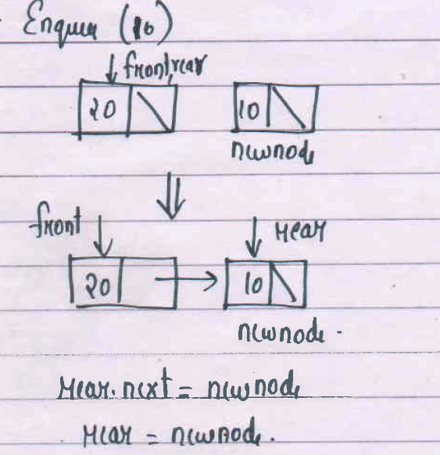

Slide 39
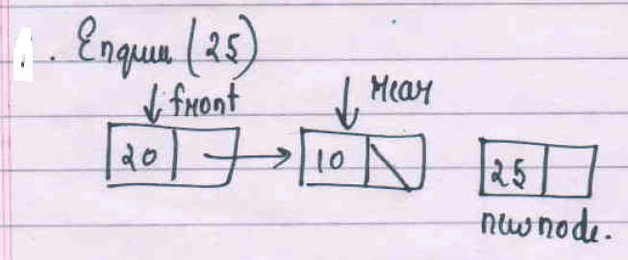

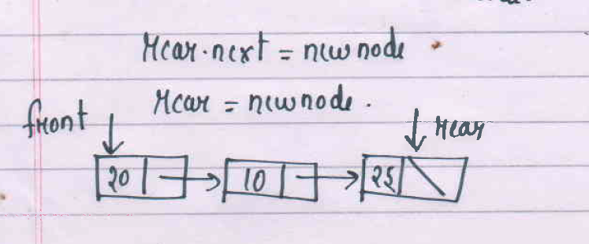

Slide 40
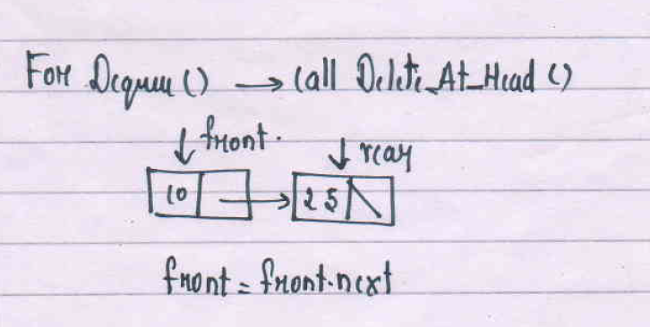

Slide 41
Enqueue(value)
Step 1: Create a newnode.
newnode.data= value, newnode.next=null.
Step2: If list is empty, then front= rear=newnode.
// here front is the head node and tail is the rear node.
Step 3: else rear.next=newnode and rear=newnode.
// rear node refrence will keep track of the last node in LL. So need to traverse to get the last node.

Slide 42
Dequeue is Delete_At_Head()
Step1: Set temp=front.
Step 2: set front=front.next
Step 3: Set temp=null.
Both Enqueue(value) and Dequeue() takes constant time. Ie O(1)

Slide 43
Summary:
Linked List
Insert
Delete
Stack using LL
Queue using LL.
// Understand the logic for all the above operations.
Write the logic in step by step. ( Detailed explanation is optional)
Understand the complexity of all the LL operations.

Slide 44
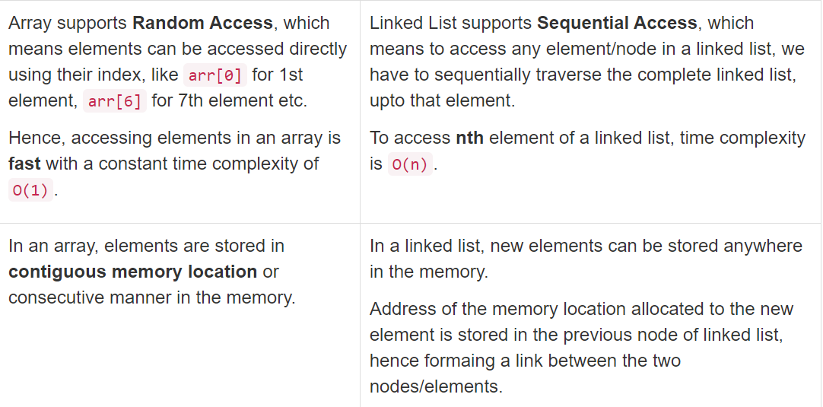

Slide 45
End Sem Portions
Recursion.
Queue and it’s applications.
Linked List.
Stack and Queue using linked list.
Algorithm Analysis Basics
Self Study: Set and Dictionary. ( no questions for end Semester)
// If extra class required on any topics you can inform before 21’st .

